Slide 1




glTF 2.0 - Status Report
Norbert Nopper, Co-founder UX3D GmbH
Khronos Munich Chapter Meeting 10/13/2017

Slide 2
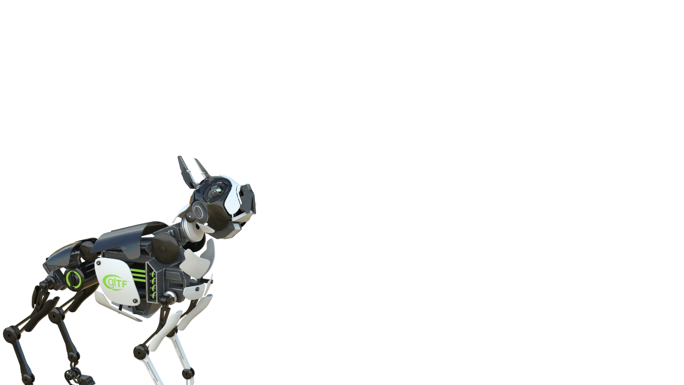

Slide 3
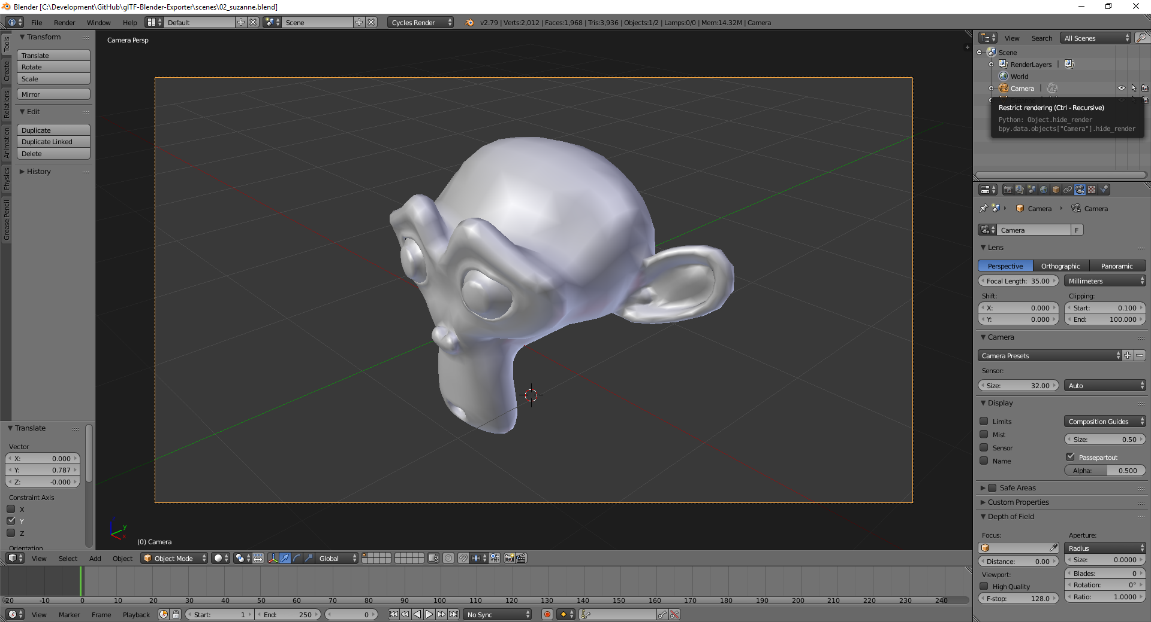
glTF 2.0 – What we have!
Sample workflow - Modelling
Asset creation with Blender 3D

Slide 4
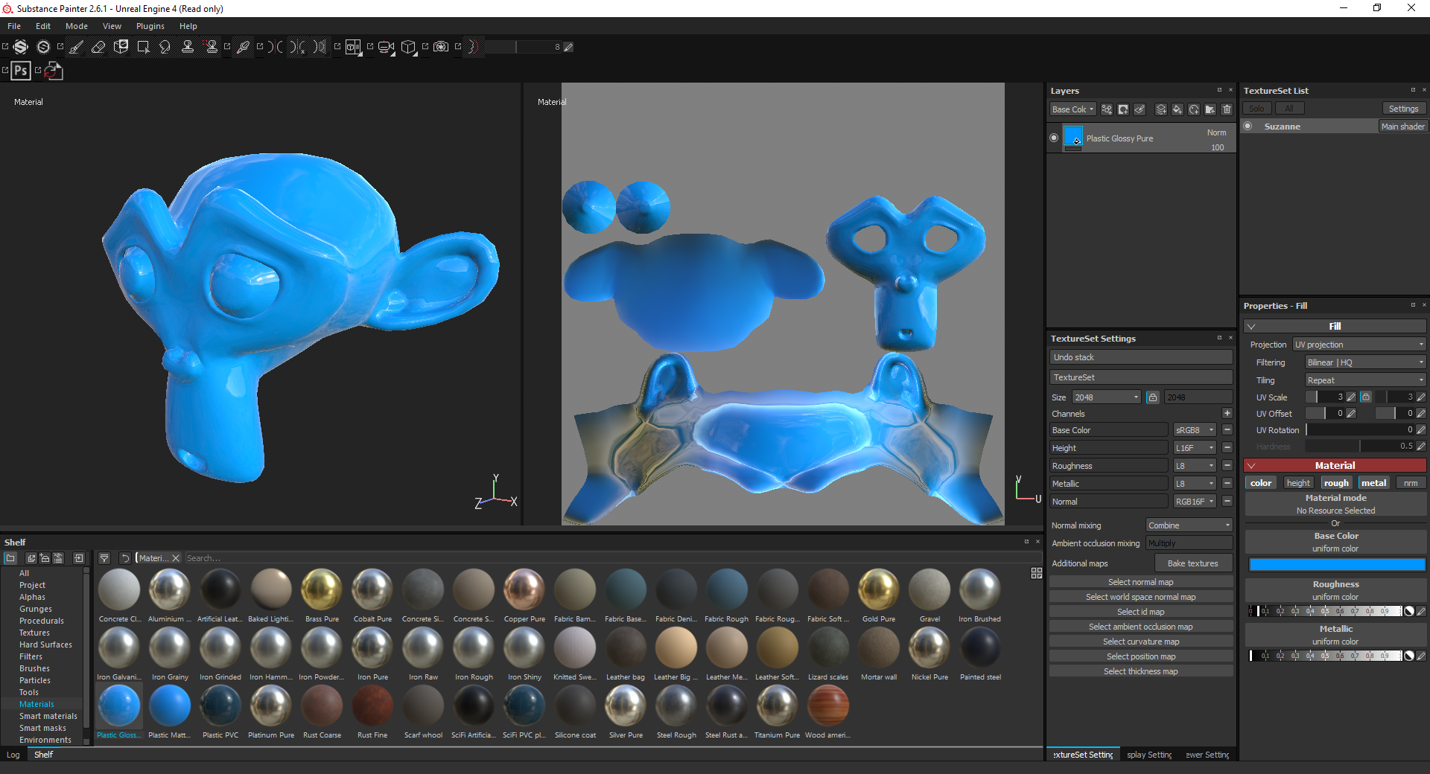
glTF 2.0 – What we have!
Sample workflow - Texturing
Substance Painter 2017.3 has glTF 2.0 export!

Slide 5
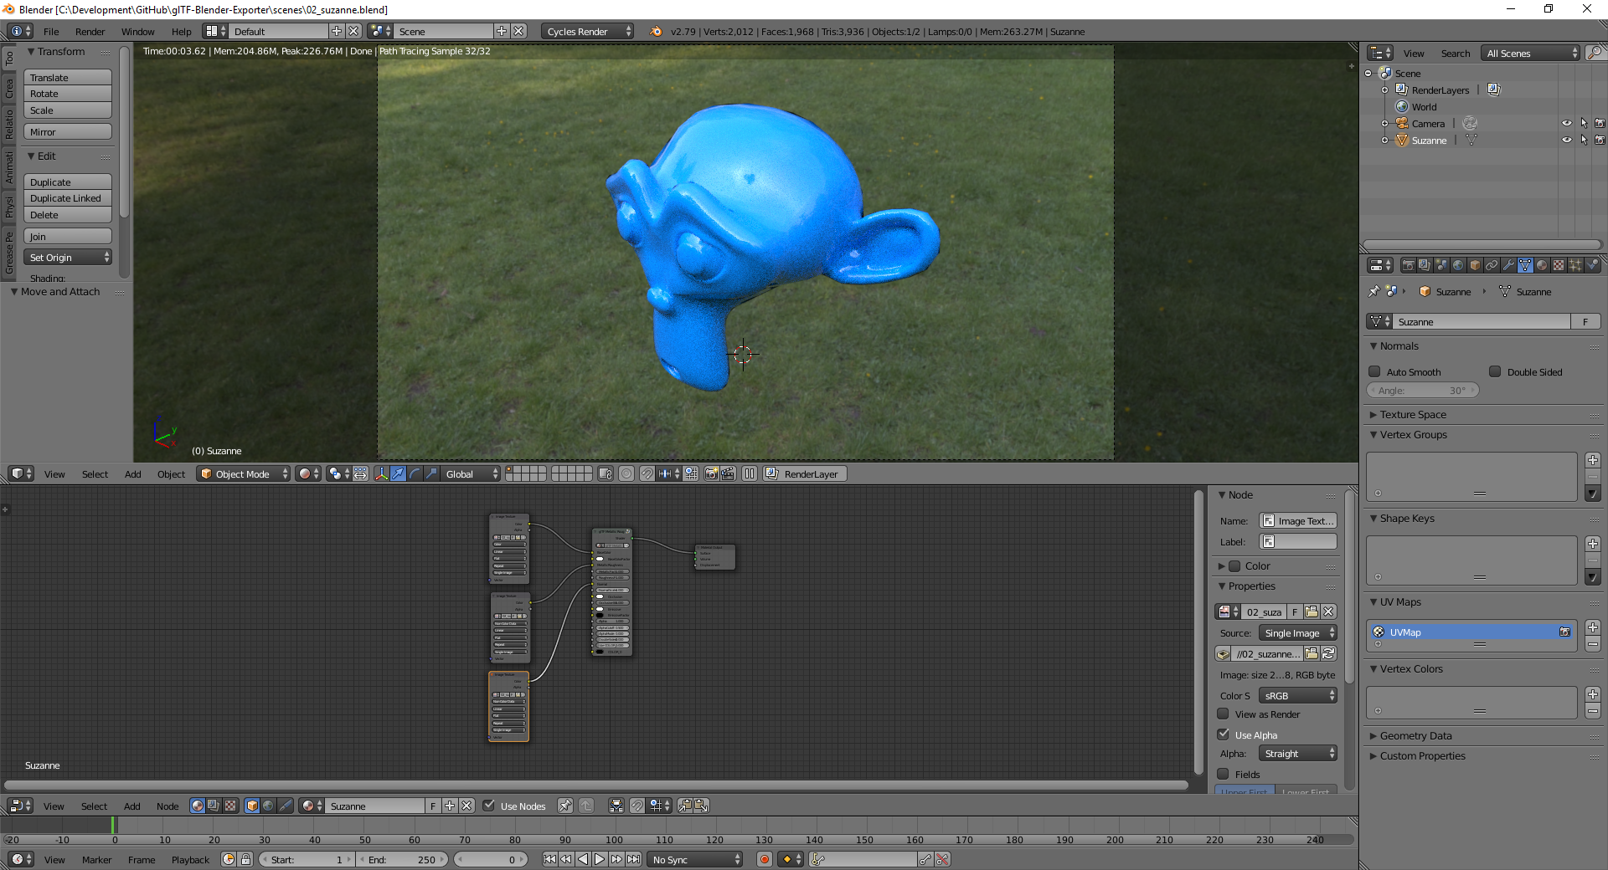
glTF 2.0 – What we have!
Sample workflow - glTF Material Setup
PBR workflow

Slide 6
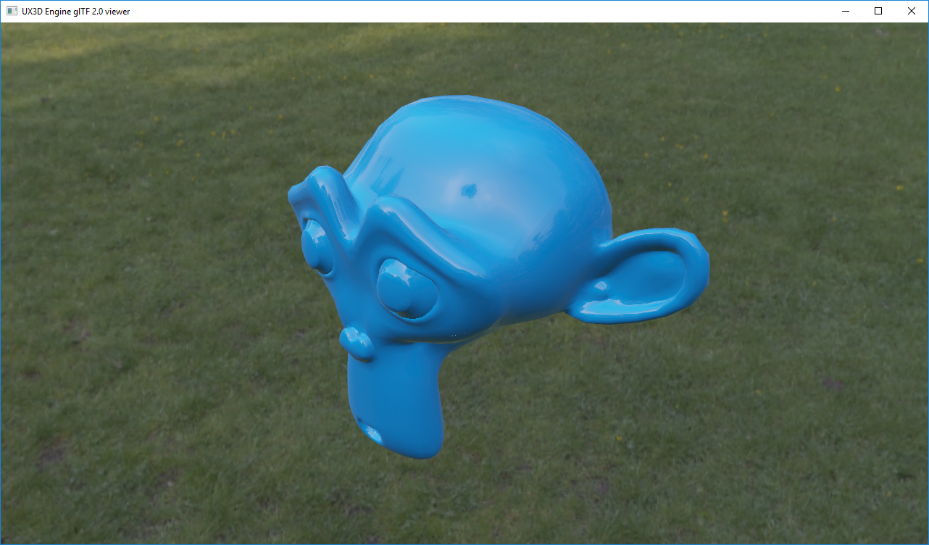
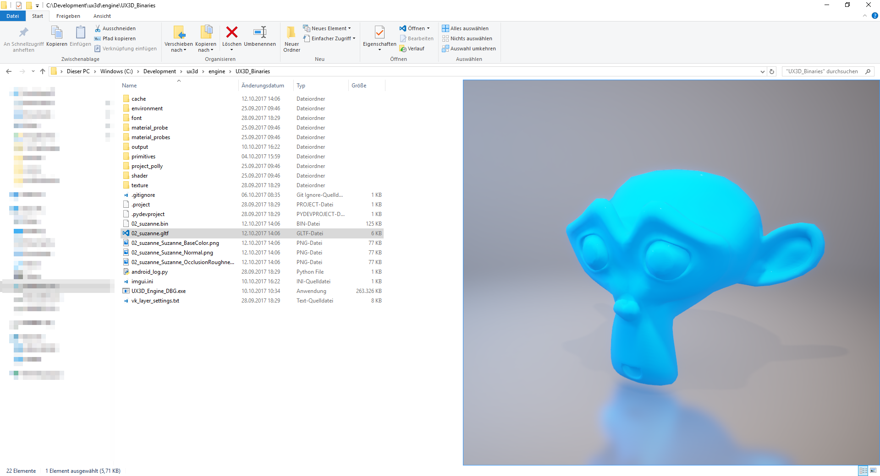
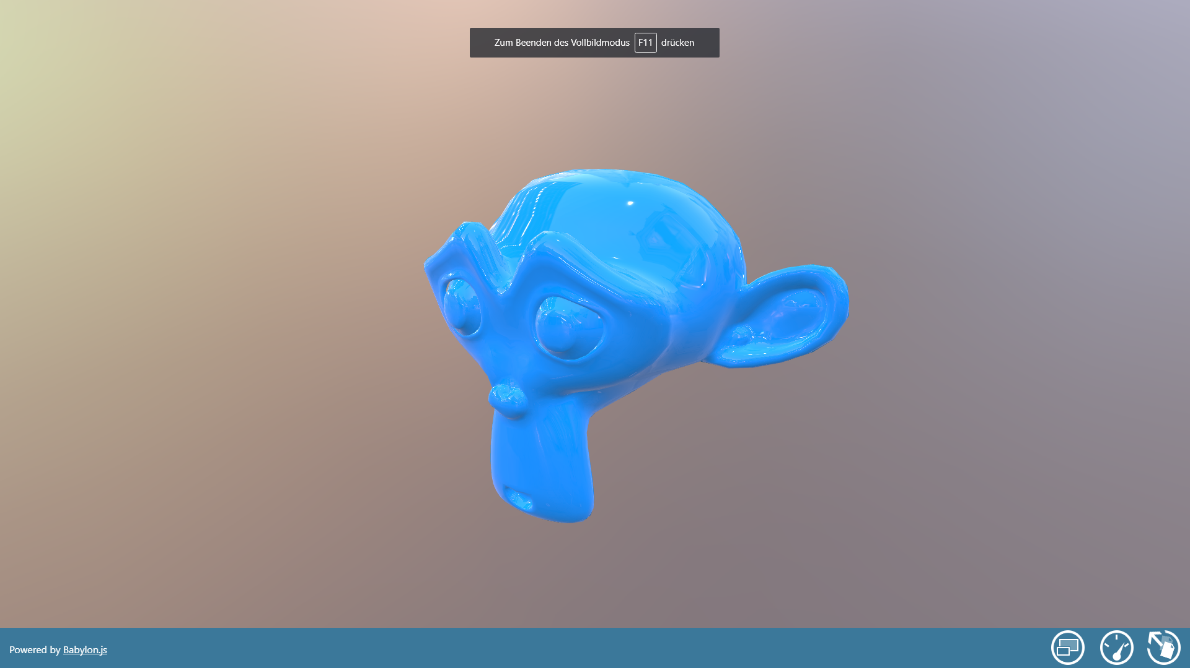
glTF 2.0 – What we have!
Render glTF 2.0 Scene in different viewers and engines

Slide 7
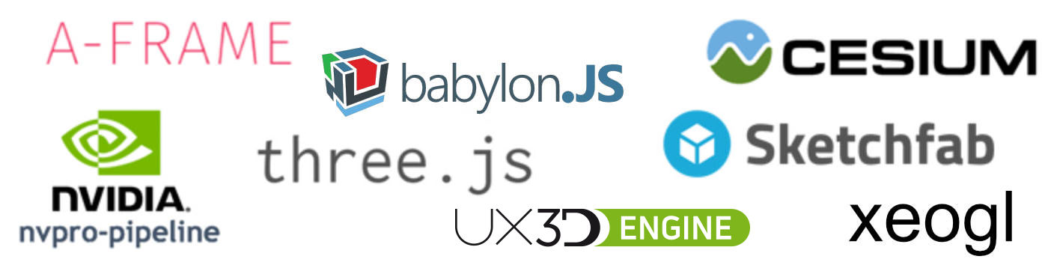
glTF 2.0 – What we have!
Apps & Engine Supporting glTF 2.0

Slide 8
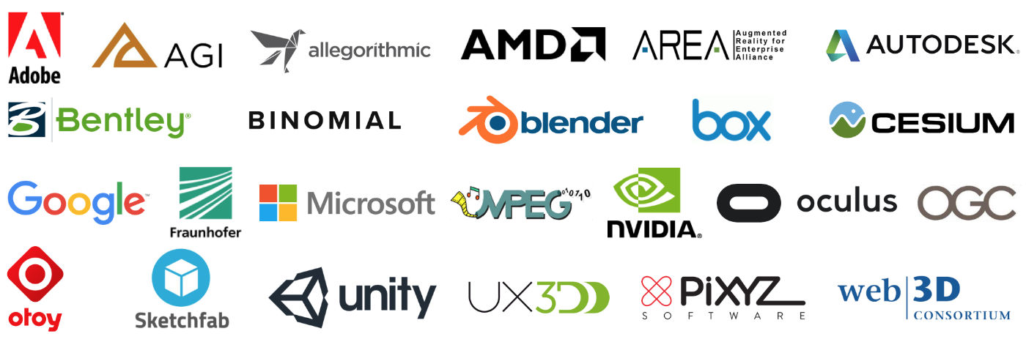
glTF 2.0 – What we have!
Industry Support for glTF

Slide 9
glTF 2.0 – What’s coming next?
glTF 2.0 Extensions and more
Draco geometry compression https://github.com/google/draco
Universal texture compression by Binomial
Common materials
Dynamic lights
Specification bug fixes

Slide 10
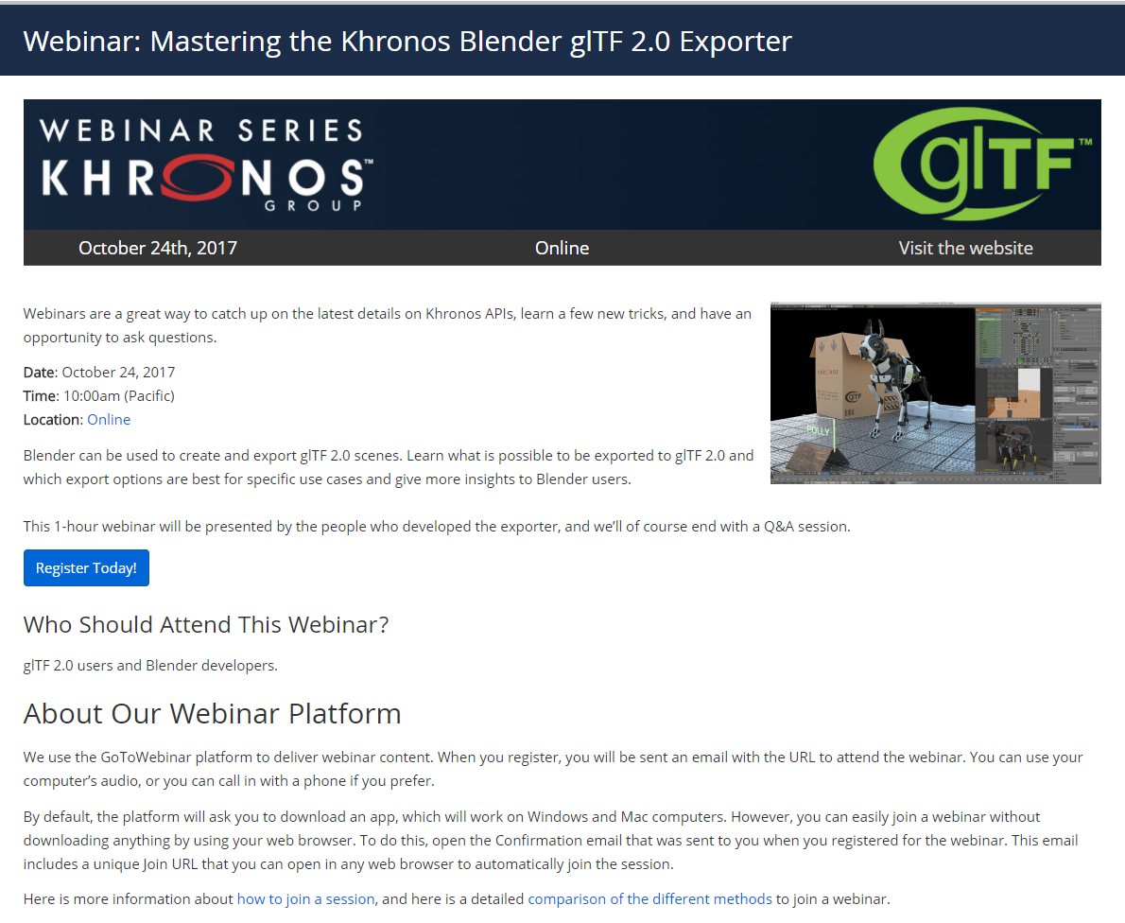
glTF 2.0 – Upcoming Webinar
Mastering the Khronos Blender glTF 2.0 Exporter
https://www.khronos.org/news/events/webinar-mastering-the-khronos-blender-gltf-2.0-exporter

Slide 11
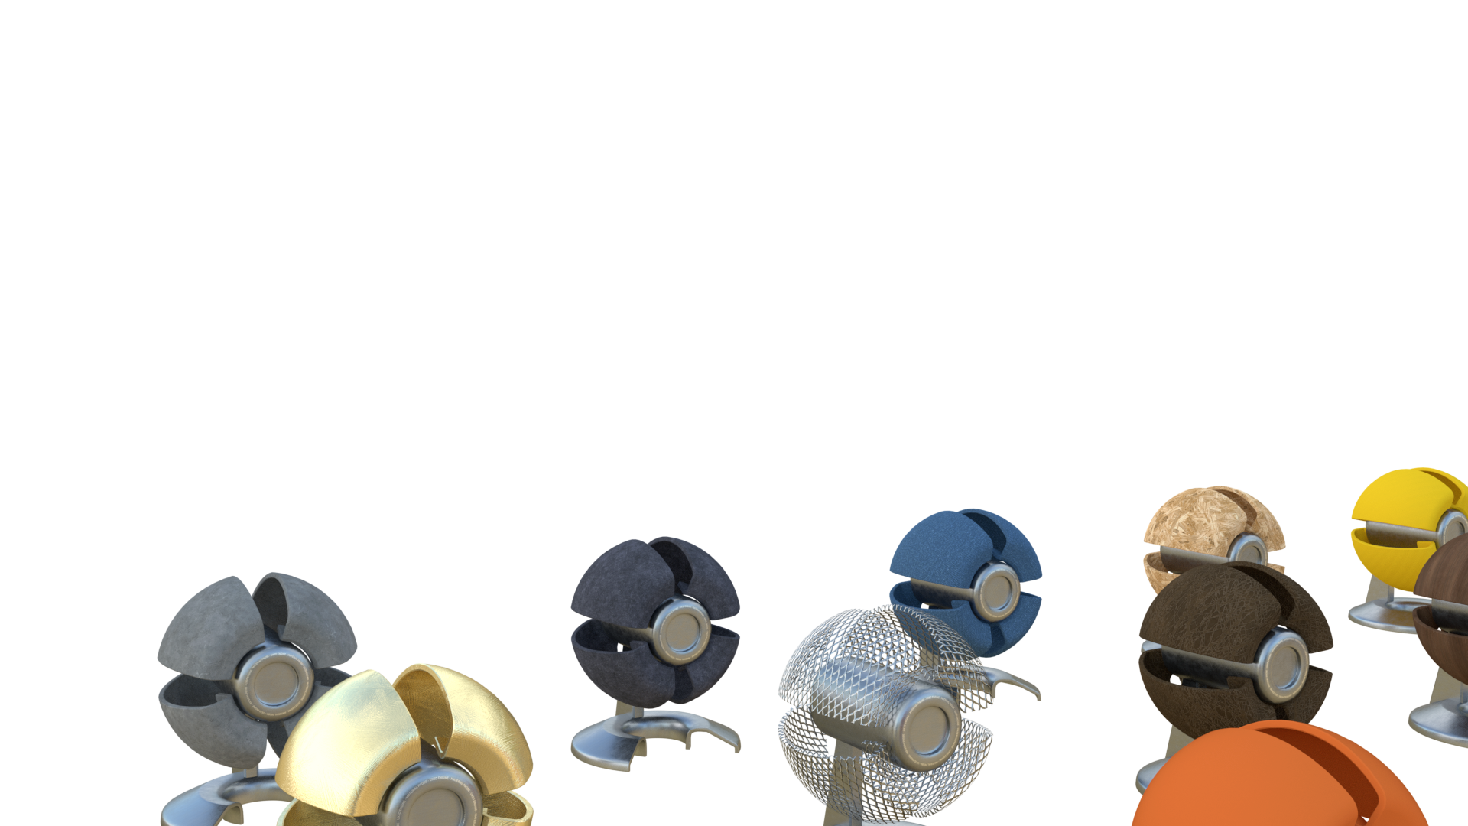
UX3D - We hire!
Join our Team
Internship
Diploma
Freelance / Contracting work
http://www.ux3d.io/career/

Slide 12
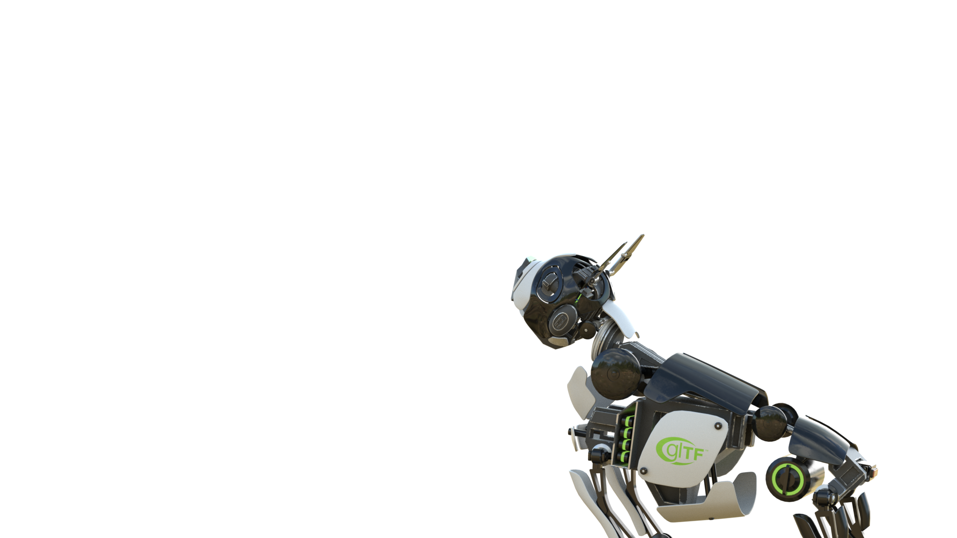
Q & A

